Slide 1
3DROCS: 3D Based Rover Operations Control System
Luc Joudrier (ESTEC), Konstantinos Kapellos (TRASYS), Kjetil Wormnes (ESTEC)
ASTRA – 16 May 2013

Slide 2
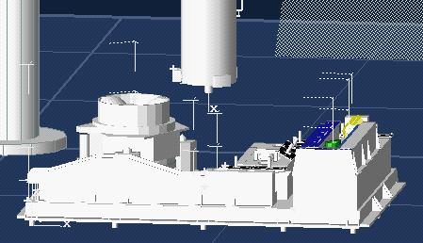
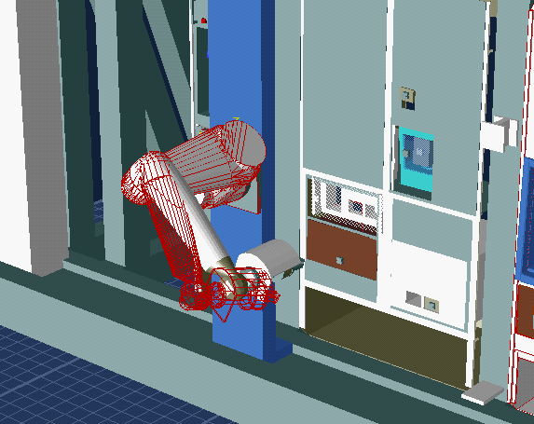
Background
3D Visualization environments are traditionally used to support robotic operations
  Preparation
  Operations
  Post-processing
In rover planetary exploration, the use of a 3D environment is even more meaningful since the location on the planet and the time an operation is executed shall be jointly considered during operations specification and data analysis.

Slide 3
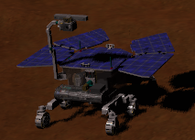


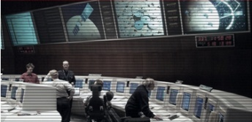
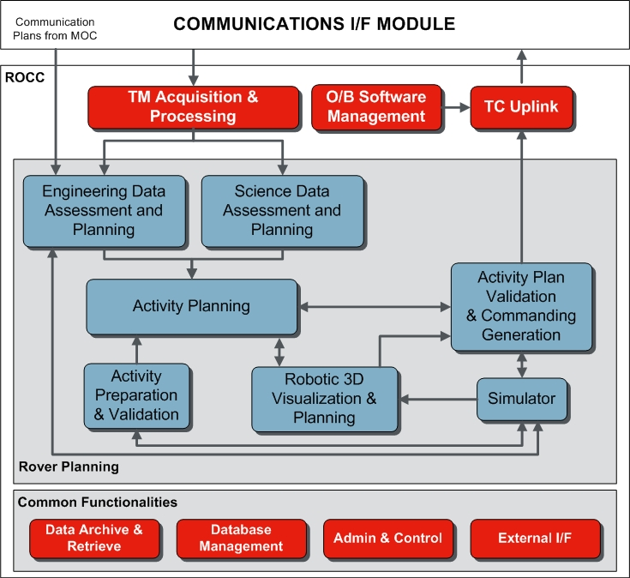
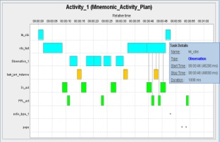
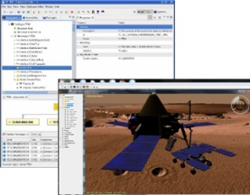
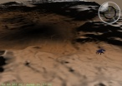
ExoMars Rover Operations
TM
Activity Plan
Rover Operations Control Centre
ExoMars Phase B: ROCS Design (GMV/TRA)

Slide 4
ExoMars Rover Operations Process
In a typical Tactical Planning process:
  Activity Plans are constructed by individual users without the possibility to validate them locally and without information about the plans proposed by the other users
  Final integration into a single, base line plan for the next sol starts only after all the individual plans have been submitted
  Many changes in the plan occur at the late stages of the process while the users are unable to understand whether or not their activities are included and if not why they have been rejected
  Accentuates the possibility of initial bad rover plans
  Increases the global planning time
4

Slide 5
3DROCS Objectives
Reduce the tactical planning process time
Increase the user awareness on the system behaviour
Facilitate the Activity Plan specification and understanding
Improve the Engineering Data Assessment process
Provide a unified interface for strategic and tactical planning
This can be achieved by introducing in the planning process:
  Collaborative work: All users may work in a shared area where the published Activity Plans can be seen by all, and each user can complete the plan specification if needed.
  Efficient any time simulations: each user is able to simulate in depth the Activity Plan under specification in order to validate it and most importantly to better understand it.
  Activity Planning and Data Analysis into a 3D environment: Activity Plans are specified graphically and engineering data are analyzed in a 3D environment.

Slide 6
3DROCS Operations Concept
3DROCS focuses on two phases of a planetary exploration mission: the Pre-launch phase and the Surface Operations phase.

Slide 7
3DROCS Operations Concept
Pre-launch phase:
  Specification of the rover Activities
  Specification and validation of Activity Plans. They are used:
    as building blocks to specify the Experiment Cycles in the form of sequences of Activity Plans
    as template Activity Plans that are adapted and reused during operations to facilitate the Tactical Planning
  Preparation of Strategic Plans
    Activity Plans and the Experiment Cycles are composed in long term Strategic Plans that implement the mission objectives.
    The Strategic Plans are used during operations as guidelines and support the tracking of the mission goals.
  Support for closed loop operations rehearsal

Slide 8
3DROCS Operations Concept
Surface Operations phase:
  Engineering Data Assessment
  Tracking and updating the mission goals
    The Strategic Plans specified during the pre-launch phase are updated wrt the executed parts of the mission and possibly adapted to the new situations discovered during operations
  Tracking Activity Planning
    Extract from the maintained strategic plan the part to be executed during the next sol(s) of interest
    Use one or more Activity Plans, already specified during the pre-launch phase, as basis for the planning
    Create and edit a completely new Activity Plan
  Updating the models

Slide 9
Overview
Planning
  Activities Specification
  Activity Plans Specification
  On-line Activity Plan Simulation
  Situational Awareness
  Collaborative Specification
Data Monitoring and Analysis
  3D Chart and Alphanumerical Displays
  3D Synoptic Displays
  3D Activity Plans Displays
  3D Images Displays
Conclusion

Slide 10
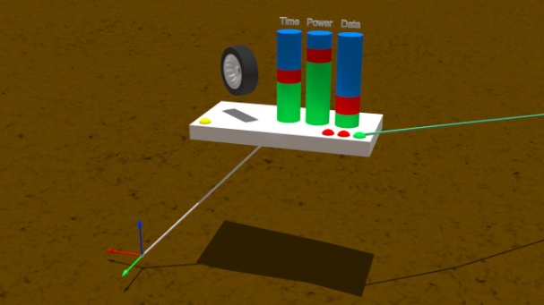
Planning – Activities Specification
Activities are the building blocks for planning
Activities are characterised by:
  A uniquely defined identifier
  A set of parameters defined by their id, their type, their size, their validity range and a short description. Application dedicated types are considered.
  A set of events: pre-conditions, post-conditions, and exceptions
  Information indicating the products to be produced during the Activity execution, their type and size as well as their downlink priority
  Information related to the 3D representation of the Activity
  A short description
Activities 3D representation visually indicates:
  The subsystem related to the Activity
  The required resources (duration, power and memory mass consumption)
  The start and end time of the Activity
  The Activity possible ends
  The location on the planetary surface the Activity is expected to take place

Slide 11
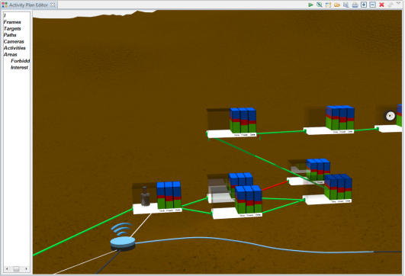
Planning – Activity Plans Specification
The Activity Plans are specified graphically in the 3D Activity Plan Editor. The operator, in the 3D canvas, manipulates graphically Activities, Activities inter-connections and group of Activities
Selects an Activity and inserts it into the Activity Plan Editor
Indicates the location the Activity takes place by connecting the 'location port' of the Activity to a point of the terrain using a line segment
Connects an output port of an Activity with the input port of one or more other Activities using oriented line segments indicating the precedence order of the Activities execution
Groups graphically a set of Activities

Slide 12
Planning – On-line Activity Plan Simulation
The Activity Plan under specification is continuously simulated. Every change in the Activity Plan specification that affects the simulated results initiates a new simulation to update the estimation of the required resources.
The 3D Activity Plan Editor:
  Updates the displayed level of resources of the Activity Plan following the simulation results
  Highlights the paths that have been simulated.
  Visualizes the communication windows together with the downloaded products
  Visualizes the significant ephemerides events
  In case of failure indicates the executed path, the last Activity that has been executed and the reason it failed
The 3DROV Simulator is integrated into 3DROCS

Slide 13


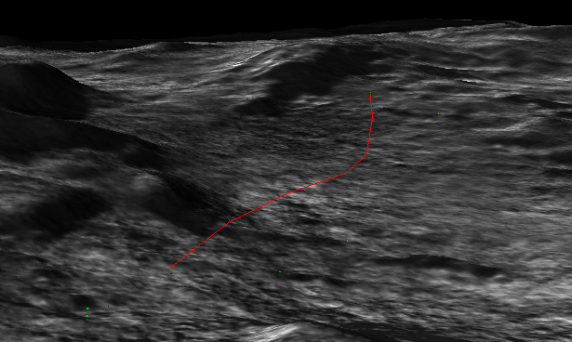
Planning – Situational Awareness
3DROCS provides predictions and aids related to the power, the communications and the mechanical subsystems.
Use of overlaid maps with possibility to access the exact value

Slide 14
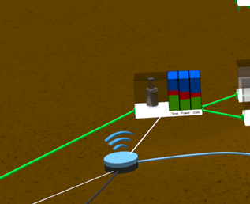
Planning – Situational Awareness
Power situational awareness:
  Global solar energy maps
  Time dependant solar energy maps
  Rover power generation maps that are energy maps overlaid on the rover panels indicating the rover power generation at the given position and solar panels configuration
Communications situational awareness
  Given an Activity Plan under specification, the system computes and visualizes in the scene the instants and the locations where the rover/orbiter communications will take place. On operators' request or by pointing over the communications glyph in the scene, specific communication information is displayed (the duration, the bit-rate, etc).

Slide 15
Planning – Situational Awareness
Mechanical Dynamics situational awareness
  Computation and visualization of the path to be followed by the rover to reach a target point
  Computation and visualization of the terrain slope maps
  Computation and visualization of reachability maps
Imaging situational awareness
  Visualization in the synthetic scene of the footprint of a selected camera
  Identification of the joint configuration of the mechanism in order to image a given area

Slide 16
Planning – Collaborative Specification
3DROCS supports collaborative specification of Activity Plans
Collaborative planning is performed over a dedicated 'session' that guarantees that all participants work on the same data, operational constraints and versions (environment model, rover model, simulator, etc)
Collaboration approach:
  The sharing of the Activity Plans is based on a check-in/check-out mechanism
  Concurrent edition of the same Activity Plan
    In the 'Synchronized View' mode several operators can view the Activity Plan in the scene in a synchronized way. The 3D scene of the Activity Plan Editors of the remote operators is rendered from the same view point as the 3D scene of the 'synchronizing' operator.
    In the ‘Concurrent edition’ mode two or more operators concurrently edit the same version of an Activity Plan. In this case, every change performed by an operator is immediately applied to all the operators.

Slide 17
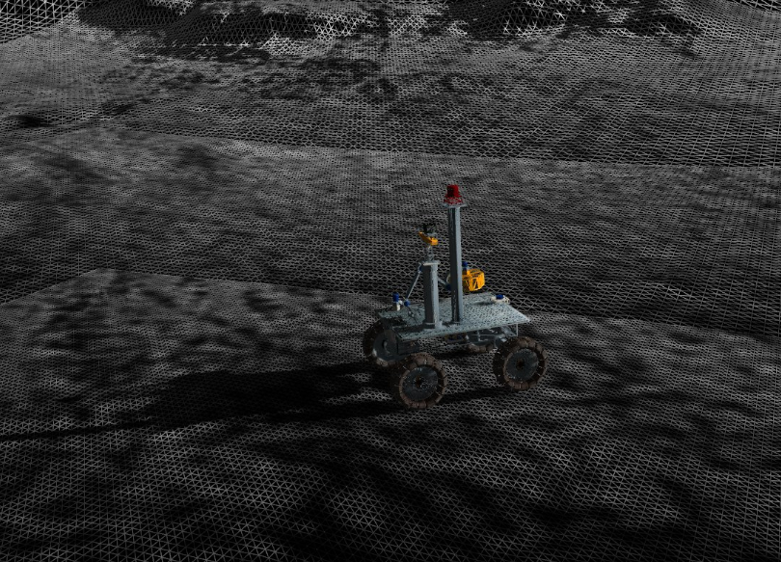
Efficient 3D Visualisation
3D Visualisation is based on the 3D component of the 3DROV Simulator
Enhancement of its capabilities (e.g. Terrain rendering using GPU-based geometry clipmaps (Arul Asirvatham, Hugues Hoppe))

Slide 18
Plan
Planning
  Activities Specification
  Activity Plans Specification
  On-line Activity Plan Simulation
  Situational Awareness
  Collaborative Specification
Data Monitoring and Analysis
  3D Chart and Alphanumerical Displays
  3D Synoptic Displays
  3D Activity Plans Displays
  3D Images Displays
Conclusion

Slide 19
Data Monitoring and Analysis
The evolution of a planetary exploration rover engineering data can be better understood when considered in their context, i.e. the location on the planet and the time have been produced. 3D Displays is the best way to visualize heterogeneous information capturing its spatiotemporal characteristics.
The operator has the possibility to:
  Configure the engineering data to be monitored and analyzed
  Monitor the engineering data during the Activity Planning process
  Monitor on-line engineering data during operations
  Post-processing engineering data in view of their analysis and operations replay
3D Displays are organized in the following types:
  3D Chart and Alphanumerical displays
  3D Activity Plans displays
  3D Synoptic displays
  3D Images displays.

Slide 20
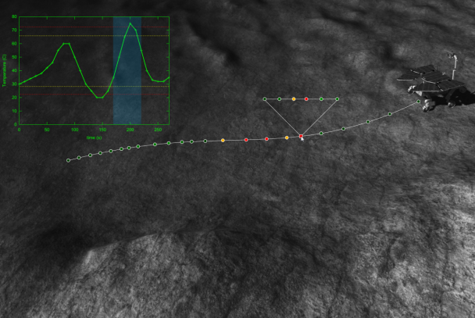
Data Monitoring and Analysis - 3D Chart and Alphanumerical Displays
The 3D chart displays provide the operator an immediate and intuitive view of the location a telemetry has been produced, the time it has been produced, a qualitative information on the telemetry, and the telemetry value itself.
Location: One or more 3D paths are generated in the 3D scene taking into account the TM position and the associated values. The color of each chart is visually encoding each associated value, the warning and the alarm regions.
Time: One or more 2D charts are generated on top of the 3D canvas. The associated values are plotted with respect to time. Indicator for the warning and alarm regions are visible on the chart.

Slide 21
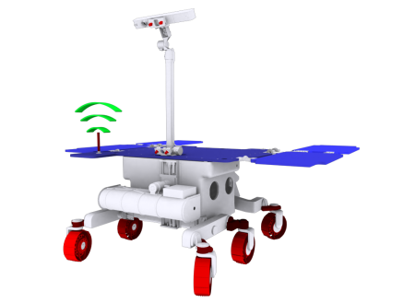
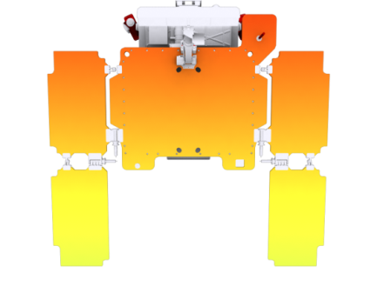
Data Monitoring and Analysis - 3D Synoptic Displays
The 3D synoptic displays provide the operator a 3D view of the rover reflecting the current status of the telemetry using visual effects
  Level of transparency
  Color change
  Color blinking
  Color gradient
  Shape change/scaling
  Cue visualization (e.g. dashed line)
  Mechanical joint animation
  Synoptic displays can also be more specialized, displaying only parts of the rover. For example a synoptic display can visualize the TM of the Drill component and another the TM of the solar panels (temperature distribution).

Slide 22
Data Monitoring and Analysis - 3D Activity Plans Displays
The 3D Activity Plans displays allow the operator to visualise and compare two Activity Plans.
  The Activity Plans to be compared shall be related in the sense that they may represent the simulated, the controlled or the executed version of the same Activity Plan.
  The branch of the planned Activity Plan that has been executed/simulated is identified and highlighted.
  Activity Plans can be compared:
    at global level (comparison between expected/controlled and achieved final resources availability, availability at a given time/location point, etc)
    at Activity level (comparison between expected and effective start time/location, duration and resources consumption)

Slide 23
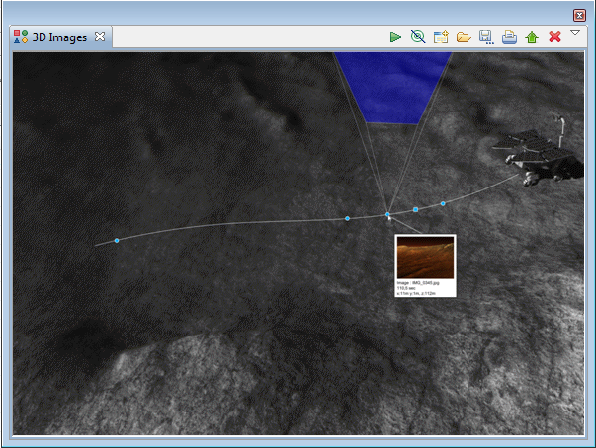
Data Monitoring and Analysis - 3D Images Displays
The 3D Images displays provide an immediate and intuitive view of all the images acquired by a given set cameras during the time period represented by the data under analysis.
  Images may be visualized either overlaid on the 3D terrain or as glyphs at the acquisition location. Activating the glyph, information on the acquired image is provided.
  On-line configuration options:
    Associate additional cameras to the display
    Associate the products stream to be visualized
    Toggle the path and the rover
    ‘Replay’ the generated images

Slide 24
Conclusion
3D Based Activity Plans specification and 3D Based data analysis improves the Activity Plan understanding
Situational awareness facilitates the planning process
Collaborative work and any time simulation reduces the tactical planning time
3DROCS is under development
Aims to support current ExoMars simulation activities
Aims to contribute to the ExoMars ROCS future developments

Slide 25

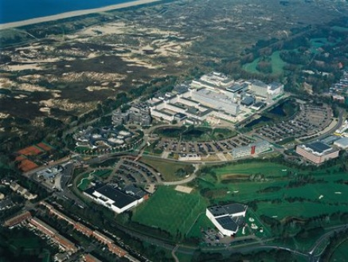
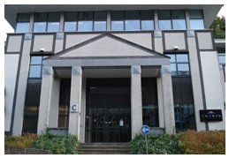
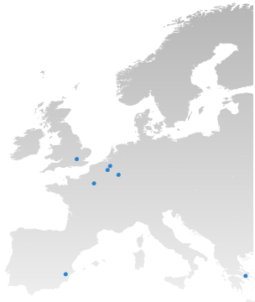
Contacts
K. Kapellos
TRASYS
Terhulpsesteenweg, 6C, 1560 Hoeilaart
Phone: +32 2 893 15 08
Fax: +32 2 893 14 00
E-mail: Konstantinos.Kapellos@trasys.be
L. Joudrier
ESA/ESTEC
Keplerlaan 1, 2201AZ Noordwijk, The Netherlands
Tel: +31-71-565-8294
Fax: +31-71-565-5419
E-mail: luc.joudrier@esa.int

